Slide 1
Machine Learning Algorithms (III-II-I)
Master´s in Applied Artificial Intelligence
Luís Ferreira
lufer@ipca.pt

Slide 2
Overview
Part I
Artificial Intelligence and Machine Learning
Foundations
Part II
Machine Learning
Part III
Machine Learning Algorithms (I)
Parte IV
Machine Learning Algorithms (Adv.)

Slide 3
Part III
Machine Learning Algorithms
Competencies to be acquired:
Feature Engineering
  Pre-Processing (data manipulation)
  Scaling

Slide 4
Part III: MLA
Features Engineering
Features Engineering [exploring business characteristics]
  Pre-Processing (handling: null values, duplicates, imbalanced dataset, outliers, etc.)
  Categories encoding (Data, Label and Ordinal Encoding)
  Categories dimensioning
  Generation and Extraction of categories
  Selecting relevant categories

Slide 5
Part III: MLA
Features Engineering
Features Pre-Processing
  Data Cleaning
  Data Integration
  Data Transformation
  Data Reduction
  Data Discretization
  Data Normalization
Reference: Data Preparation for Machine Learning, Jason Brownlee
Notes:
Data Cleaning: This involves identifying and correcting errors or inconsistencies in the data, such as missing values, outliers, and duplicates;
Data Integration: This involves combining data from multiple sources to create a unified dataset;
Data Transformation: This involves converting the data into a suitable format for analysis; Common techniques used in data transformation include normalization, standardization, and discretization. Normalization is used to scale the data to a common range, while standardization is used to transform the data to have zero mean and unit variance
Data Reduction: This involves reducing the size of the dataset while preserving the important information; Data reduction can be achieved through techniques such as feature selection and feature extraction. Feature selection involves selecting a subset of relevant features from the dataset, while feature extraction involves transforming the data into a lower-dimensional space while preserving the important information
Data Discretization: This involves dividing continuous data into discrete categories or intervals; Discretization is often used in data mining and machine learning algorithms that require categorical data. Discretization can be achieved through techniques such as equal width binning, equal frequency binning, and clustering
Data Normalization: This involves scaling the data to a common range, such as between 0 and 1 or -1 and 1. Normalization is often used to handle data with different units and scales. Common normalization techniques include min-max normalization, z-score normalization, and decimal scaling
Fonte: https://www.geeksforgeeks.org/data-preprocessing-in-data-mining/

Slide 6
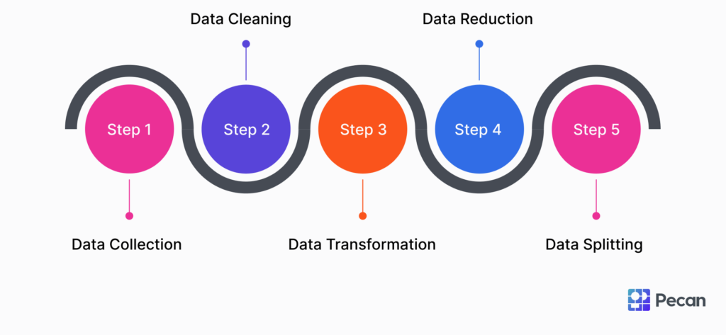
Part III: MLA
Features Engineering
Features Pre-Processing
  Data Cleaning
  Data Integration
  Data Transformation
  Data Reduction
  Data Discretization
  Data Normalization
Reference: Data Preparation for Machine Learning, Jason Brownlee
Notes:
Data Cleaning: This involves identifying and correcting errors or inconsistencies in the data, such as missing values, outliers, and duplicates;
Data Integration: This involves combining data from multiple sources to create a unified dataset;
Data Transformation: This involves converting the data into a suitable format for analysis; Common techniques used in data transformation include normalization, standardization, and discretization. Normalization is used to scale the data to a common range, while standardization is used to transform the data to have zero mean and unit variance
Data Reduction: This involves reducing the size of the dataset while preserving the important information; Data reduction can be achieved through techniques such as feature selection and feature extraction. Feature selection involves selecting a subset of relevant features from the dataset, while feature extraction involves transforming the data into a lower-dimensional space while preserving the important information
Data Discretization: This involves dividing continuous data into discrete categories or intervals; Discretization is often used in data mining and machine learning algorithms that require categorical data. Discretization can be achieved through techniques such as equal width binning, equal frequency binning, and clustering
Data Normalization: This involves scaling the data to a common range, such as between 0 and 1 or -1 and 1. Normalization is often used to handle data with different units and scales. Common normalization techniques include min-max normalization, z-score normalization, and decimal scaling
Fonte: https://www.geeksforgeeks.org/data-preprocessing-in-data-mining/

Slide 7
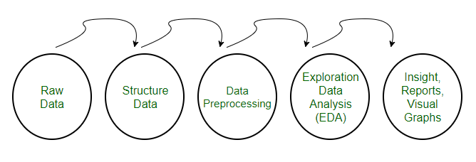
Part III: MLA
Features Engineering
Features Pre-Processing
  Data Cleaning
  Data Integration
  Data Transformation
  Data Reduction
  Data Discretization
  Data Normalization
ETL
Features Engineering
Adapted from: https://medium.com/analytics-vidhya/normalization-vs-standardization-8937f45b3e20
Notes:
Data Cleaning: This involves identifying and correcting errors or inconsistencies in the data, such as missing values, outliers, and duplicates;
Data Integration: This involves combining data from multiple sources to create a unified dataset;
Data Transformation: This involves converting the data into a suitable format for analysis; Common techniques used in data transformation include normalization, standardization, and discretization. Normalization is used to scale the data to a common range, while standardization is used to transform the data to have zero mean and unit variance
Data Reduction: This involves reducing the size of the dataset while preserving the important information; Data reduction can be achieved through techniques such as feature selection and feature extraction. Feature selection involves selecting a subset of relevant features from the dataset, while feature extraction involves transforming the data into a lower-dimensional space while preserving the important information
Data Discretization: This involves dividing continuous data into discrete categories or intervals; Discretization is often used in data mining and machine learning algorithms that require categorical data. Discretization can be achieved through techniques such as equal width binning, equal frequency binning, and clustering
Data Normalization: This involves scaling the data to a common range, such as between 0 and 1 or -1 and 1. Normalization is often used to handle data with different units and scales. Common normalization techniques include min-max normalization, z-score normalization, and decimal scaling
Fonte: https://www.geeksforgeeks.org/data-preprocessing-in-data-mining/

Slide 8
Part III: MLA
Features Engineering - concepts
Data Collection and Integration: involves combining data from multiple sources to create a unified dataset;
Data Cleaning: involves identifying and correcting errors or inconsistencies in the data, such as missing values, outliers, and duplicates;
Data Transformation: involves converting the data into a suitable format for analysis; Common techniques used in data transformation include normalization, standardization, and discretization. Normalization is used to scale the data to a common range, while standardization is used to transform the data to have zero mean and unit variance
Data Reduction: involves reducing the size of the dataset while preserving the important information; Data reduction can be achieved through techniques such as feature selection and feature extraction. Feature selection involves selecting a subset of relevant features from the dataset, while feature extraction involves transforming the data into a lower-dimensional space while preserving the important information
Notes:
Data Cleaning: This involves identifying and correcting errors or inconsistencies in the data, such as missing values, outliers, and duplicates;
Data Integration: This involves combining data from multiple sources to create a unified dataset;
Data Transformation: This involves converting the data into a suitable format for analysis; Common techniques used in data transformation include normalization, standardization, and discretization. Normalization is used to scale the data to a common range, while standardization is used to transform the data to have zero mean and unit variance
Data Reduction: This involves reducing the size of the dataset while preserving the important information; Data reduction can be achieved through techniques such as feature selection and feature extraction. Feature selection involves selecting a subset of relevant features from the dataset, while feature extraction involves transforming the data into a lower-dimensional space while preserving the important information
Data Discretization: This involves dividing continuous data into discrete categories or intervals; Discretization is often used in data mining and machine learning algorithms that require categorical data. Discretization can be achieved through techniques such as equal width binning, equal frequency binning, and clustering
Data Normalization: This involves scaling the data to a common range, such as between 0 and 1 or -1 and 1. Normalization is often used to handle data with different units and scales. Common normalization techniques include min-max normalization, z-score normalization, and decimal scaling
Fonte: https://www.geeksforgeeks.org/data-preprocessing-in-data-mining/

Slide 9
Part III: MLA
Features Engineering - concepts
Data Collection and Integration involves combining data from multiple sources to create a unified dataset;
Data Cleaning: involves identifying and correcting errors or inconsistencies in the data, such as missing values, outliers, and duplicates;
Data Transformation: involves converting the data into a suitable format for analysis; Common techniques used in data transformation include normalization, standardization, and discretization. Normalization is used to scale the data to a common range, while standardization is used to transform the data to have zero mean and unit variance
Data Reduction: involves reducing the size of the dataset while preserving the important information; Data reduction can be achieved through techniques such as feature selection and feature extraction. Feature selection involves selecting a subset of relevant features from the dataset, while feature extraction involves transforming the data into a lower-dimensional space while preserving the important information
Data Collection and Integration: involves combining data from multiple sources to create a unified dataset;
Data Cleaning: involves identifying and correcting errors or inconsistencies in the data, such as missing values, outliers, and duplicates;
Data Transformation: involves converting the data into a suitable format for analysis; Common techniques used in data transformation include normalization, standardization, and discretization. Normalization is used to scale the data to a common range, while standardization is used to transform the data to have zero mean and unit variance
Data Reduction: involves reducing the size of the dataset while preserving the important information; Data reduction can be achieved through techniques such as feature selection and feature extraction. Feature selection involves selecting a subset of relevant features from the dataset, while feature extraction involves transforming the data into a lower-dimensional space while preserving the important information
Adapted from: https://www.geeksforgeeks.org/data-preprocessing-in-data-mining/
Notes:
Data Cleaning: This involves identifying and correcting errors or inconsistencies in the data, such as missing values, outliers, and duplicates;
Data Integration: This involves combining data from multiple sources to create a unified dataset;
Data Transformation: This involves converting the data into a suitable format for analysis; Common techniques used in data transformation include normalization, standardization, and discretization. Normalization is used to scale the data to a common range, while standardization is used to transform the data to have zero mean and unit variance
Data Reduction: This involves reducing the size of the dataset while preserving the important information; Data reduction can be achieved through techniques such as feature selection and feature extraction. Feature selection involves selecting a subset of relevant features from the dataset, while feature extraction involves transforming the data into a lower-dimensional space while preserving the important information
Data Discretization: This involves dividing continuous data into discrete categories or intervals; Discretization is often used in data mining and machine learning algorithms that require categorical data. Discretization can be achieved through techniques such as equal width binning, equal frequency binning, and clustering
Data Normalization: This involves scaling the data to a common range, such as between 0 and 1 or -1 and 1. Normalization is often used to handle data with different units and scales. Common normalization techniques include min-max normalization, z-score normalization, and decimal scaling
Fonte: https://www.geeksforgeeks.org/data-preprocessing-in-data-mining/

Slide 10
Part III: MLA
Features Engineering - concepts
Feature scaling
Data Normalization: involves scaling the data to a common range, such as between 0 and 1 or -1 and 1. Normalization is often used to handle data with different units and scales. Common normalization techniques include min-max normalization, z-score normalization, decimal scaling, mean normalization (mean-centering)
When:
Unknown or Non-Gaussian Distribution: when the distribution of data is not known or does not follow a normal (Gaussian) pattern;
Distance-Based Algorithms: when training rely on distances between data points, such as k-Nearest Neighbors (k-NN), to prevent features with larger scales from dominating the distance calculations
Notes:
Data Cleaning: This involves identifying and correcting errors or inconsistencies in the data, such as missing values, outliers, and duplicates;
Data Integration: This involves combining data from multiple sources to create a unified dataset;
Data Transformation: This involves converting the data into a suitable format for analysis; Common techniques used in data transformation include normalization, standardization, and discretization. Normalization is used to scale the data to a common range, while standardization is used to transform the data to have zero mean and unit variance
Data Reduction: This involves reducing the size of the dataset while preserving the important information; Data reduction can be achieved through techniques such as feature selection and feature extraction. Feature selection involves selecting a subset of relevant features from the dataset, while feature extraction involves transforming the data into a lower-dimensional space while preserving the important information
Data Discretization: This involves dividing continuous data into discrete categories or intervals; Discretization is often used in data mining and machine learning algorithms that require categorical data. Discretization can be achieved through techniques such as equal width binning, equal frequency binning, and clustering
Data Normalization: This involves scaling the data to a common range, such as between 0 and 1 or -1 and 1. Normalization is often used to handle data with different units and scales. Common normalization techniques include min-max normalization, z-score normalization, and decimal scaling
Fonte: https://www.geeksforgeeks.org/data-preprocessing-in-data-mining/

Slide 11
Part III: MLA
Features Engineering - concepts
Feature scaling
Data Normalization: involves scaling the data to a common range, such as between 0 and 1 or -1 and 1. Normalization is often used to handle data with different units and scales. Common normalization techniques include min-max normalization, z-score normalization, decimal scaling, mean normalization (mean-centering)
When:
Unknown or Non-Gaussian Distribution: when the distribution of data is not known or does not follow a normal (Gaussian) pattern;
Distance-Based Algorithms: when training rely on distances between data points, such as k-Nearest Neighbors (k-NN), to prevent features with larger scales from dominating the distance calculations
…eliminate potential distortions caused by differing scales or units…
… ensure that no single feature dominates the others due to its magnitude
Notes:
Data Cleaning: This involves identifying and correcting errors or inconsistencies in the data, such as missing values, outliers, and duplicates;
Data Integration: This involves combining data from multiple sources to create a unified dataset;
Data Transformation: This involves converting the data into a suitable format for analysis; Common techniques used in data transformation include normalization, standardization, and discretization. Normalization is used to scale the data to a common range, while standardization is used to transform the data to have zero mean and unit variance
Data Reduction: This involves reducing the size of the dataset while preserving the important information; Data reduction can be achieved through techniques such as feature selection and feature extraction. Feature selection involves selecting a subset of relevant features from the dataset, while feature extraction involves transforming the data into a lower-dimensional space while preserving the important information
Data Discretization: This involves dividing continuous data into discrete categories or intervals; Discretization is often used in data mining and machine learning algorithms that require categorical data. Discretization can be achieved through techniques such as equal width binning, equal frequency binning, and clustering
Data Normalization: This involves scaling the data to a common range, such as between 0 and 1 or -1 and 1. Normalization is often used to handle data with different units and scales. Common normalization techniques include min-max normalization, z-score normalization, and decimal scaling
Fonte: https://www.geeksforgeeks.org/data-preprocessing-in-data-mining/

Slide 12
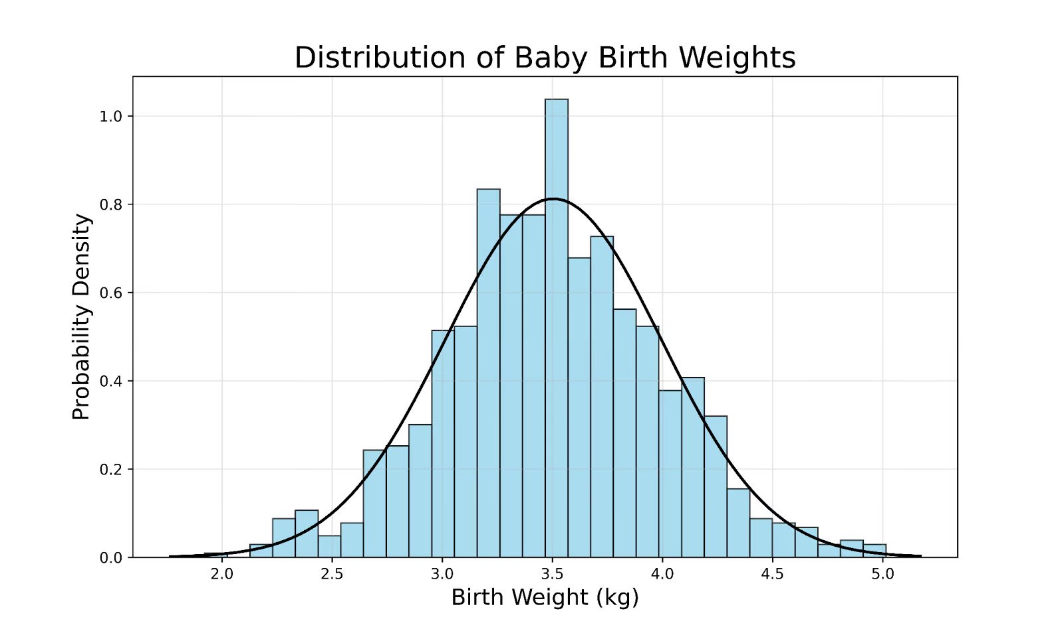
Part III: MLA
Features Engineering - concepts
Feature scaling
Data Normalization: involves scaling the data to a common range, such as between 0 and 1 or -1 and 1. Normalization is often used to handle data with different units and scales. Common normalization techniques include min-max normalization, z-score normalization, decimal scaling, mean normalization (mean-centering)
When:
Unknown or Non-Gaussian Distribution: when the distribution of data is not known or does not follow a normal (Gaussian) pattern;
Distance-Based Algorithms: when training rely on distances between data points, such as k-Nearest Neighbors (k-NN), to prevent features with larger scales from dominating the distance calculations
Which models require normalized data? https://www.yourdatateacher.com/2022/06/13/which-models-require-normalized-data/
Notes:
Data Cleaning: This involves identifying and correcting errors or inconsistencies in the data, such as missing values, outliers, and duplicates;
Data Integration: This involves combining data from multiple sources to create a unified dataset;
Data Transformation: This involves converting the data into a suitable format for analysis; Common techniques used in data transformation include normalization, standardization, and discretization. Normalization is used to scale the data to a common range, while standardization is used to transform the data to have zero mean and unit variance
Data Reduction: This involves reducing the size of the dataset while preserving the important information; Data reduction can be achieved through techniques such as feature selection and feature extraction. Feature selection involves selecting a subset of relevant features from the dataset, while feature extraction involves transforming the data into a lower-dimensional space while preserving the important information
Data Discretization: This involves dividing continuous data into discrete categories or intervals; Discretization is often used in data mining and machine learning algorithms that require categorical data. Discretization can be achieved through techniques such as equal width binning, equal frequency binning, and clustering
Data Normalization: This involves scaling the data to a common range, such as between 0 and 1 or -1 and 1. Normalization is often used to handle data with different units and scales. Common normalization techniques include min-max normalization, z-score normalization, and decimal scaling
Fonte: https://www.geeksforgeeks.org/data-preprocessing-in-data-mining/

Slide 13
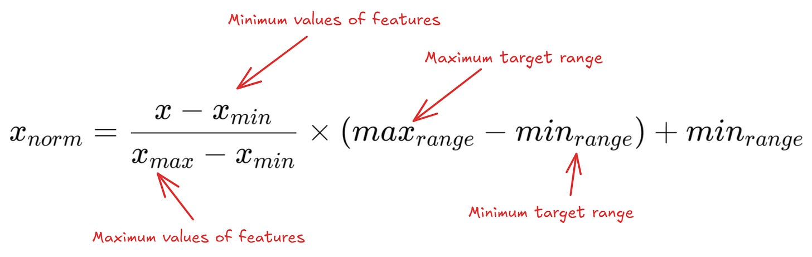
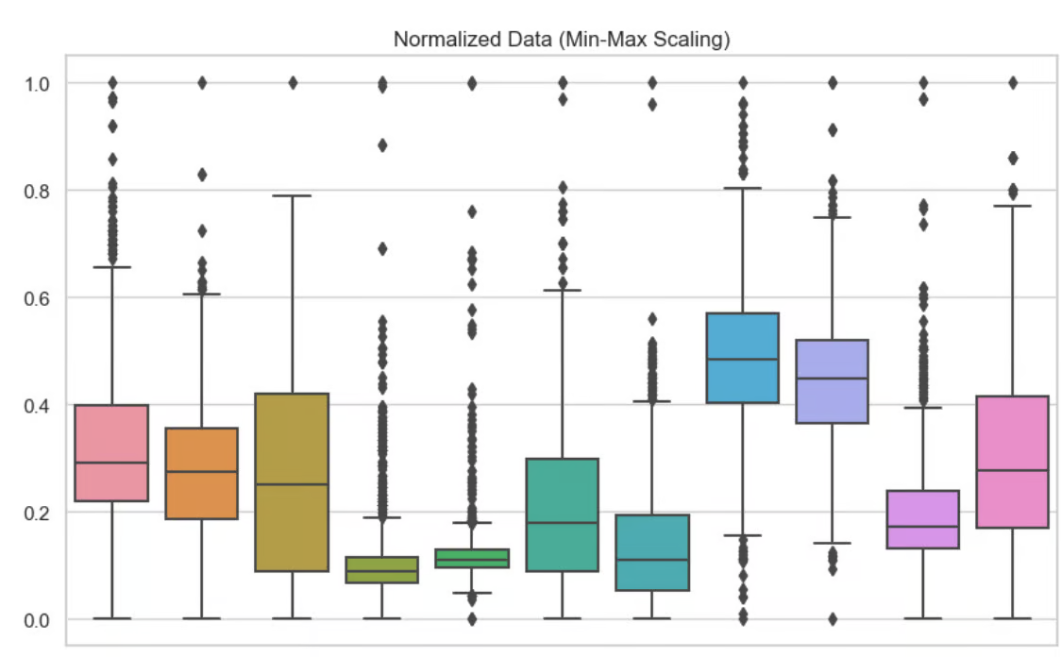
Part III: MLA
Features Engineering - concepts
Feature scaling
Data Normalization: involves scaling the data to a common range, such as between 0 and 1 or -1 and 1. Normalization is often used to handle data with different units and scales. Common normalization techniques include min-max normalization, z-score normalization, decimal scaling, mean normalization (mean-centering)
When:
Unknown or Non-Gaussian Distribution: when the distribution of data is not known or does not follow a normal (Gaussian) pattern;
Distance-Based Algorithms: when training rely on distances between data points, such as k-Nearest Neighbors (k-NN), to prevent features with larger scales from dominating the distance calculations
Which models require normalized data? https://www.yourdatateacher.com/2022/06/13/which-models-require-normalized-data/
Notes:
Data Cleaning: This involves identifying and correcting errors or inconsistencies in the data, such as missing values, outliers, and duplicates;
Data Integration: This involves combining data from multiple sources to create a unified dataset;
Data Transformation: This involves converting the data into a suitable format for analysis; Common techniques used in data transformation include normalization, standardization, and discretization. Normalization is used to scale the data to a common range, while standardization is used to transform the data to have zero mean and unit variance
Data Reduction: This involves reducing the size of the dataset while preserving the important information; Data reduction can be achieved through techniques such as feature selection and feature extraction. Feature selection involves selecting a subset of relevant features from the dataset, while feature extraction involves transforming the data into a lower-dimensional space while preserving the important information
Data Discretization: This involves dividing continuous data into discrete categories or intervals; Discretization is often used in data mining and machine learning algorithms that require categorical data. Discretization can be achieved through techniques such as equal width binning, equal frequency binning, and clustering
Data Normalization: This involves scaling the data to a common range, such as between 0 and 1 or -1 and 1. Normalization is often used to handle data with different units and scales. Common normalization techniques include min-max normalization, z-score normalization, and decimal scaling
Fonte: https://www.geeksforgeeks.org/data-preprocessing-in-data-mining/

Slide 14
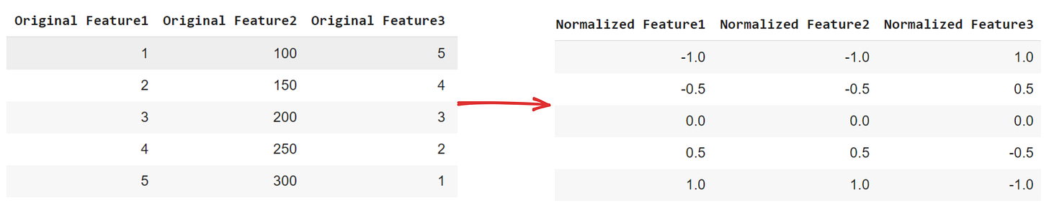
Part III: MLA
Features Engineering - concepts
Feature scaling
Data Normalization: involves scaling the data to a common range, such as between 0 and 1 or -1 and 1. Normalization is often used to handle data with different units and scales. Common normalization techniques include min-max normalization, z-score normalization, decimal scaling, mean normalization (mean-centering)
When:
Unknown or Non-Gaussian Distribution: when the distribution of data is not known or does not follow a normal (Gaussian) pattern;
Distance-Based Algorithms: when training rely on distances between data points, such as k-Nearest Neighbors (k-NN), to prevent features with larger scales from dominating the distance calculations
Which models require normalized data? https://www.yourdatateacher.com/2022/06/13/which-models-require-normalized-data/
Notes:
Data Cleaning: This involves identifying and correcting errors or inconsistencies in the data, such as missing values, outliers, and duplicates;
Data Integration: This involves combining data from multiple sources to create a unified dataset;
Data Transformation: This involves converting the data into a suitable format for analysis; Common techniques used in data transformation include normalization, standardization, and discretization. Normalization is used to scale the data to a common range, while standardization is used to transform the data to have zero mean and unit variance
Data Reduction: This involves reducing the size of the dataset while preserving the important information; Data reduction can be achieved through techniques such as feature selection and feature extraction. Feature selection involves selecting a subset of relevant features from the dataset, while feature extraction involves transforming the data into a lower-dimensional space while preserving the important information
Data Discretization: This involves dividing continuous data into discrete categories or intervals; Discretization is often used in data mining and machine learning algorithms that require categorical data. Discretization can be achieved through techniques such as equal width binning, equal frequency binning, and clustering
Data Normalization: This involves scaling the data to a common range, such as between 0 and 1 or -1 and 1. Normalization is often used to handle data with different units and scales. Common normalization techniques include min-max normalization, z-score normalization, and decimal scaling
Fonte: https://www.geeksforgeeks.org/data-preprocessing-in-data-mining/

Slide 15
Part III: MLA
Features Engineering - concepts
Feature scaling
Data Standardization: transforms data to have a mean of 0 and a standard deviation of 1. This process adjusts the feature values by subtracting the mean and dividing by the standard deviation. Pragmatically, first ‘centering’ and the ‘scaling’ data.
When:
Gradient-based Algorithms: when features vary widely in magnitude, helping ensure balanced contributions from each feature and improving optimization (ex. SVM)
Dimensionality Reduction: Standardization is in dimensionality reduction techniques like Principal Component Analysis (PCA), where maintaining the correct feature variance is important.
See: https://www.datacamp.com/tutorial/normalization-vs-standardization?dc_referrer=https%3A%2F%2Fwww.google.com%2F
Notes:
PCA - Principal Component Analysis (PCA)

Slide 16
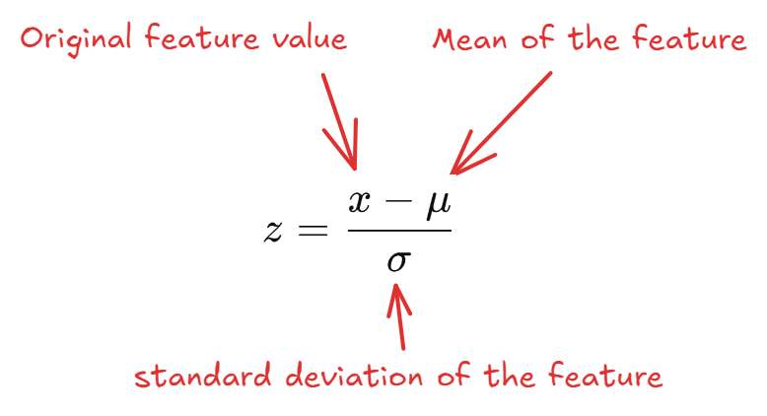
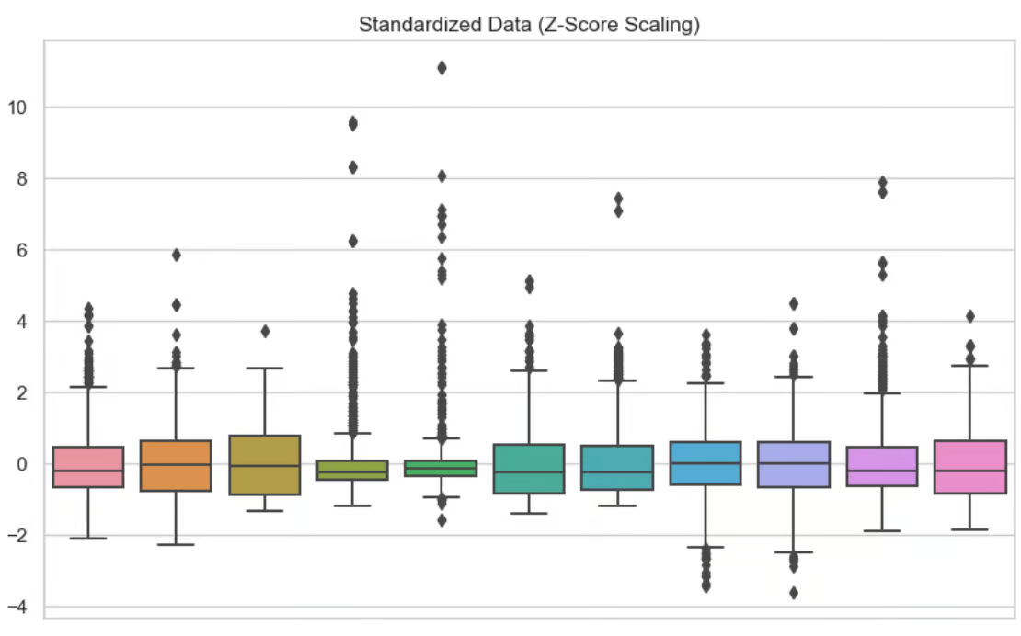
Part III: MLA
Features Engineering - concepts
Feature scaling
Data Standardization: transforms data to have a mean of 0 and a standard deviation of 1. This process adjusts the feature values by subtracting the mean and dividing by the standard deviation. Pragmatically, first ‘centering’ and the ‘scaling’ data.
When:
Gradient-based Algorithms: when features vary widely in magnitude, helping ensure balanced contributions from each feature and improving optimization (ex. SVM)
Dimensionality Reduction: Standardization is in dimensionality reduction techniques like PCA, where maintaining the correct feature variance is important.
See: https://www.datacamp.com/tutorial/normalization-vs-standardization?dc_referrer=https%3A%2F%2Fwww.google.com%2F
Notes:
Data Cleaning: This involves identifying and correcting errors or inconsistencies in the data, such as missing values, outliers, and duplicates;
Data Integration: This involves combining data from multiple sources to create a unified dataset;
Data Transformation: This involves converting the data into a suitable format for analysis; Common techniques used in data transformation include normalization, standardization, and discretization. Normalization is used to scale the data to a common range, while standardization is used to transform the data to have zero mean and unit variance
Data Reduction: This involves reducing the size of the dataset while preserving the important information; Data reduction can be achieved through techniques such as feature selection and feature extraction. Feature selection involves selecting a subset of relevant features from the dataset, while feature extraction involves transforming the data into a lower-dimensional space while preserving the important information
Data Discretization: This involves dividing continuous data into discrete categories or intervals; Discretization is often used in data mining and machine learning algorithms that require categorical data. Discretization can be achieved through techniques such as equal width binning, equal frequency binning, and clustering
Data Normalization: This involves scaling the data to a common range, such as between 0 and 1 or -1 and 1. Normalization is often used to handle data with different units and scales. Common normalization techniques include min-max normalization, z-score normalization, and decimal scaling
Fonte: https://www.geeksforgeeks.org/data-preprocessing-in-data-mining/

Slide 17
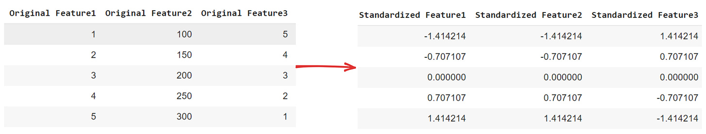
Part III: MLA
Features Engineering - concepts
Feature scaling
Data Standardization: transforms data to have a mean of 0 and a standard deviation of 1. This process adjusts the feature values by subtracting the mean and dividing by the standard deviation. Pragmatically, first ‘centering’ and the ‘scaling’ data.
When:
Gradient-based Algorithms: when features vary widely in magnitude, helping ensure balanced contributions from each feature and improving optimization (ex. SVM)
Dimensionality Reduction: Standardization is in dimensionality reduction techniques like PCA, where maintaining the correct feature variance is important.
See: https://www.datacamp.com/tutorial/normalization-vs-standardization?dc_referrer=https%3A%2F%2Fwww.google.com%2F
Notes:
Data Cleaning: This involves identifying and correcting errors or inconsistencies in the data, such as missing values, outliers, and duplicates;
Data Integration: This involves combining data from multiple sources to create a unified dataset;
Data Transformation: This involves converting the data into a suitable format for analysis; Common techniques used in data transformation include normalization, standardization, and discretization. Normalization is used to scale the data to a common range, while standardization is used to transform the data to have zero mean and unit variance
Data Reduction: This involves reducing the size of the dataset while preserving the important information; Data reduction can be achieved through techniques such as feature selection and feature extraction. Feature selection involves selecting a subset of relevant features from the dataset, while feature extraction involves transforming the data into a lower-dimensional space while preserving the important information
Data Discretization: This involves dividing continuous data into discrete categories or intervals; Discretization is often used in data mining and machine learning algorithms that require categorical data. Discretization can be achieved through techniques such as equal width binning, equal frequency binning, and clustering
Data Normalization: This involves scaling the data to a common range, such as between 0 and 1 or -1 and 1. Normalization is often used to handle data with different units and scales. Common normalization techniques include min-max normalization, z-score normalization, and decimal scaling
Fonte: https://www.geeksforgeeks.org/data-preprocessing-in-data-mining/

Slide 18
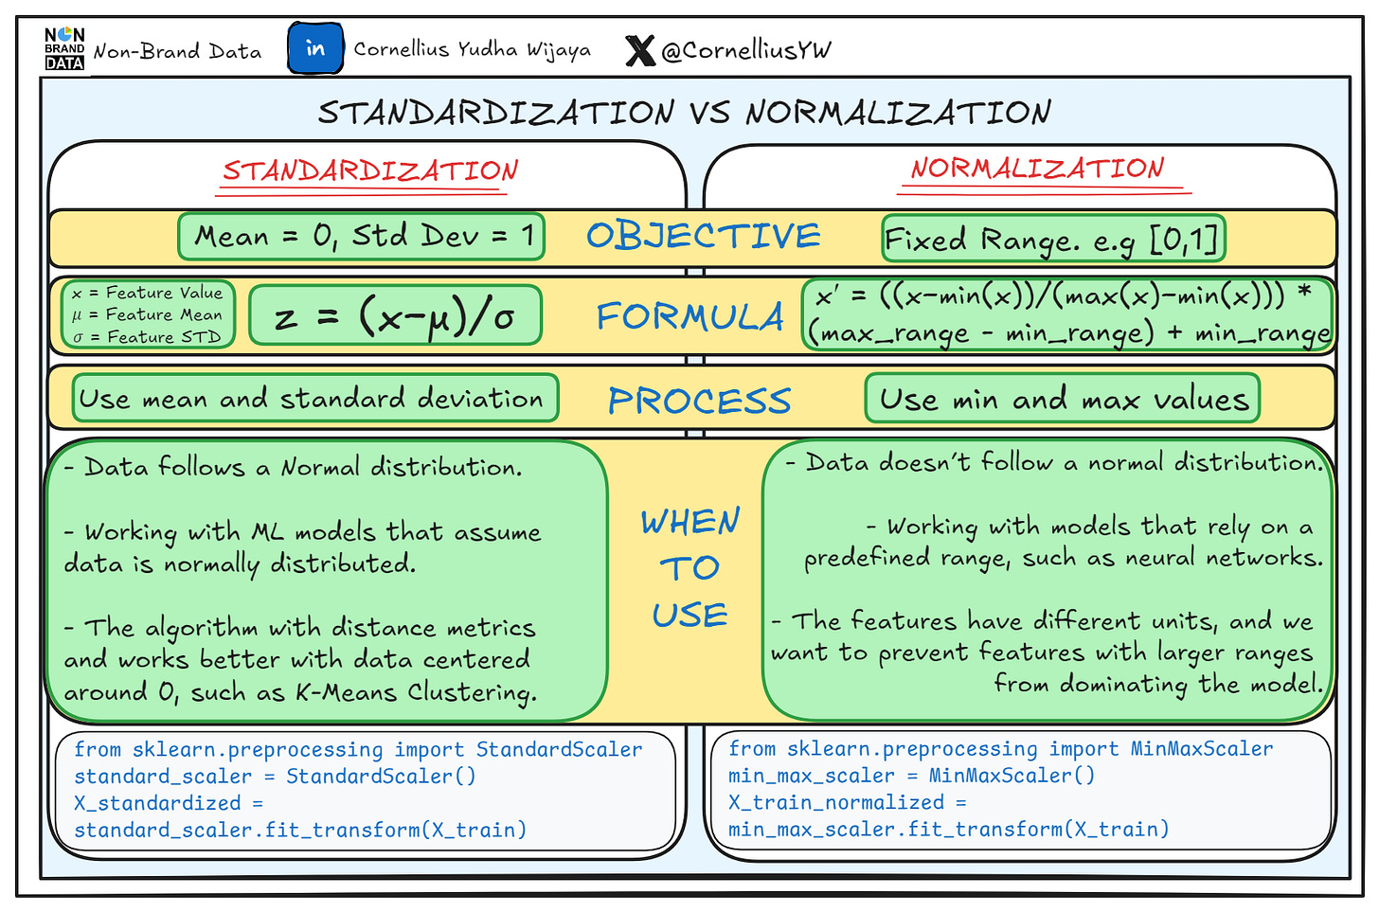
Part III: MLA
Features Engineering - concepts
Feature scaling
Data Standardization: transforms data to have a mean of 0 and a standard deviation of 1. This process adjusts the feature values by subtracting the mean and dividing by the standard deviation. Pragmatically, first ‘centering’ and the ‘scaling’ data.
When:
Gradient-based Algorithms: when features vary widely in magnitude, helping ensure balanced contributions from each feature and improving optimization (ex. SVM)
Dimensionality Reduction: Standardization is in dimensionality reduction techniques like PCA, where maintaining the correct feature variance is important.
See: https://www.datacamp.com/tutorial/normalization-vs-standardization?dc_referrer=https%3A%2F%2Fwww.google.com%2F
https://www.nb-data.com/p/standardization-vs-normalization
Notes:
Data Cleaning: This involves identifying and correcting errors or inconsistencies in the data, such as missing values, outliers, and duplicates;
Data Integration: This involves combining data from multiple sources to create a unified dataset;
Data Transformation: This involves converting the data into a suitable format for analysis; Common techniques used in data transformation include normalization, standardization, and discretization. Normalization is used to scale the data to a common range, while standardization is used to transform the data to have zero mean and unit variance
Data Reduction: This involves reducing the size of the dataset while preserving the important information; Data reduction can be achieved through techniques such as feature selection and feature extraction. Feature selection involves selecting a subset of relevant features from the dataset, while feature extraction involves transforming the data into a lower-dimensional space while preserving the important information
Data Discretization: This involves dividing continuous data into discrete categories or intervals; Discretization is often used in data mining and machine learning algorithms that require categorical data. Discretization can be achieved through techniques such as equal width binning, equal frequency binning, and clustering
Data Normalization: This involves scaling the data to a common range, such as between 0 and 1 or -1 and 1. Normalization is often used to handle data with different units and scales. Common normalization techniques include min-max normalization, z-score normalization, and decimal scaling
Fonte: https://www.geeksforgeeks.org/data-preprocessing-in-data-mining/

Slide 19
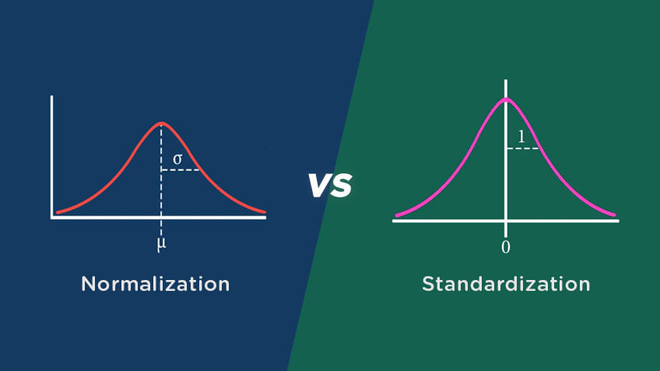
Part III: MLA
Features Engineering - concepts
Feature scaling
Data Standardization: transforms data to have a mean of 0 and a standard deviation of 1. This process adjusts the feature values by subtracting the mean and dividing by the standard deviation. Pragmatically, first ‘centering’ and the ‘scaling’ data.
When:
Gradient-based Algorithms: when features vary widely in magnitude, helping ensure balanced contributions from each feature and improving optimization (ex. SVM)
Dimensionality Reduction: Standardization is in dimensionality reduction techniques like PCA, where maintaining the correct feature variance is important.
μ (mean)
σ (standard deviation)
See: https://www.simplilearn.com/normalization-vs-standardization-article
Notes:
Data Cleaning: This involves identifying and correcting errors or inconsistencies in the data, such as missing values, outliers, and duplicates;
Data Integration: This involves combining data from multiple sources to create a unified dataset;
Data Transformation: This involves converting the data into a suitable format for analysis; Common techniques used in data transformation include normalization, standardization, and discretization. Normalization is used to scale the data to a common range, while standardization is used to transform the data to have zero mean and unit variance
Data Reduction: This involves reducing the size of the dataset while preserving the important information; Data reduction can be achieved through techniques such as feature selection and feature extraction. Feature selection involves selecting a subset of relevant features from the dataset, while feature extraction involves transforming the data into a lower-dimensional space while preserving the important information
Data Discretization: This involves dividing continuous data into discrete categories or intervals; Discretization is often used in data mining and machine learning algorithms that require categorical data. Discretization can be achieved through techniques such as equal width binning, equal frequency binning, and clustering
Data Normalization: This involves scaling the data to a common range, such as between 0 and 1 or -1 and 1. Normalization is often used to handle data with different units and scales. Common normalization techniques include min-max normalization, z-score normalization, and decimal scaling
Fonte: https://www.geeksforgeeks.org/data-preprocessing-in-data-mining/

Slide 20
Part III: MLA
Features Engineering - concepts
New features only or maintains the original one?
…overwriting the column does not lose mathematical information, but it can loses the human-readable original values unless you store the scaling parameters…
Note: in ML, apply the same transformation to:
validation data
test data
new incoming data
Feature scaling
Data Standardization: transforms data to have a mean of 0 and a standard deviation of 1. This process adjusts the feature values by subtracting the mean and dividing by the standard deviation. Pragmatically, first ‘centering’ and the ‘scaling’ data.
When:
Gradient-based Algorithms: when features vary widely in magnitude, helping ensure balanced contributions from each feature and improving optimization (ex. SVM)
Dimensionality Reduction: Standardization is in dimensionality reduction techniques like PCA, where maintaining the correct feature variance is important.
See: https://www.simplilearn.com/normalization-vs-standardization-article
Notes:
Data Cleaning: This involves identifying and correcting errors or inconsistencies in the data, such as missing values, outliers, and duplicates;
Data Integration: This involves combining data from multiple sources to create a unified dataset;
Data Transformation: This involves converting the data into a suitable format for analysis; Common techniques used in data transformation include normalization, standardization, and discretization. Normalization is used to scale the data to a common range, while standardization is used to transform the data to have zero mean and unit variance
Data Reduction: This involves reducing the size of the dataset while preserving the important information; Data reduction can be achieved through techniques such as feature selection and feature extraction. Feature selection involves selecting a subset of relevant features from the dataset, while feature extraction involves transforming the data into a lower-dimensional space while preserving the important information
Data Discretization: This involves dividing continuous data into discrete categories or intervals; Discretization is often used in data mining and machine learning algorithms that require categorical data. Discretization can be achieved through techniques such as equal width binning, equal frequency binning, and clustering
Data Normalization: This involves scaling the data to a common range, such as between 0 and 1 or -1 and 1. Normalization is often used to handle data with different units and scales. Common normalization techniques include min-max normalization, z-score normalization, and decimal scaling
Fonte: https://www.geeksforgeeks.org/data-preprocessing-in-data-mining/

Slide 21
Part III: MLA
Features Engineering - concepts
Data Discretization: involves dividing continuous data into discrete categories or intervals, i.e., replaces continuous features with the corresponding categorical features; Used in algorithms that require categorical data. Common techniques equal width binning, equal frequency binning, and clustering
Data Continuization: Given a data table, return a new table in which the discretize attributes are replaced with continuous or removed.
binary variables are transformed into 0.0/1.0 or -1.0/1.0 indicator variables, depending upon the argument zero_based.
discrete attributes with only one possible value is removed;
multinomial variables are treated according to the intends (parameter multinomial_treatment)
Notes:
Data Cleaning: This involves identifying and correcting errors or inconsistencies in the data, such as missing values, outliers, and duplicates;
Data Integration: This involves combining data from multiple sources to create a unified dataset;
Data Transformation: This involves converting the data into a suitable format for analysis; Common techniques used in data transformation include normalization, standardization, and discretization. Normalization is used to scale the data to a common range, while standardization is used to transform the data to have zero mean and unit variance
Data Reduction: This involves reducing the size of the dataset while preserving the important information; Data reduction can be achieved through techniques such as feature selection and feature extraction. Feature selection involves selecting a subset of relevant features from the dataset, while feature extraction involves transforming the data into a lower-dimensional space while preserving the important information
Data Discretization: This involves dividing continuous data into discrete categories or intervals; Discretization is often used in data mining and machine learning algorithms that require categorical data. Discretization can be achieved through techniques such as equal width binning, equal frequency binning, and clustering
Data Normalization: This involves scaling the data to a common range, such as between 0 and 1 or -1 and 1. Normalization is often used to handle data with different units and scales. Common normalization techniques include min-max normalization, z-score normalization, and decimal scaling
Fonte: https://www.geeksforgeeks.org/data-preprocessing-in-data-mining/

Slide 22
Part III: MLA
Features Engineering - concepts
Data Discretization: involves dividing continuous data into discrete categories or intervals, i.e., replaces continuous features with the corresponding categorical features; Used in algorithms that require categorical data. Common techniques equal width binning, equal frequency binning, and clustering
Data Continuization: Given a data table, return a new table in which the discretize attributes are replaced with continuous or removed.
binary variables are transformed into 0.0/1.0 or -1.0/1.0 indicator variables, depending upon the argument zero_based.
discrete attributes with only one possible value is removed;
multinomial variables are treated according to the intends (parameter multinomial_treatment)
See https://towardsdatascience.com/discretization-explained-a-visual-guide-with-code-examples-for-beginners-f056af9102fa/
Notes:
Data Cleaning: This involves identifying and correcting errors or inconsistencies in the data, such as missing values, outliers, and duplicates;
Data Integration: This involves combining data from multiple sources to create a unified dataset;
Data Transformation: This involves converting the data into a suitable format for analysis; Common techniques used in data transformation include normalization, standardization, and discretization. Normalization is used to scale the data to a common range, while standardization is used to transform the data to have zero mean and unit variance
Data Reduction: This involves reducing the size of the dataset while preserving the important information; Data reduction can be achieved through techniques such as feature selection and feature extraction. Feature selection involves selecting a subset of relevant features from the dataset, while feature extraction involves transforming the data into a lower-dimensional space while preserving the important information
Data Discretization: This involves dividing continuous data into discrete categories or intervals; Discretization is often used in data mining and machine learning algorithms that require categorical data. Discretization can be achieved through techniques such as equal width binning, equal frequency binning, and clustering
Data Normalization: This involves scaling the data to a common range, such as between 0 and 1 or -1 and 1. Normalization is often used to handle data with different units and scales. Common normalization techniques include min-max normalization, z-score normalization, and decimal scaling
Fonte: https://www.geeksforgeeks.org/data-preprocessing-in-data-mining/

Slide 23
Part III: MLA
Features Engineering
Features Pre-Processing
  Handling null values
    H1: Excludes instances that have null values
    H2: Replace (inputting) null values:
      Numeric values: using mean or median
      Categorical: using mode, or others!
See section “Cleaning Data” in 2_Data_Manipulation_I.ipynb
Notes:
Média
A média (M_{e}) é calculada somando todos os valores de um conjunto de dados e dividindo este valor pelo número de elementos deste conjunto.
Moda
A Mediana (M_{d}) representa o valor central de um conjunto de dados. Para encontrar o valor da mediana é necessário colocar os valores em ordem crescente ou decrescente.
Mediana
A Mediana (M_{d}) representa o valor central de um conjunto de dados. Para encontrar o valor da mediana é necessário colocar os valores em ordem crescente ou decrescente.

Slide 24
Part III: MLA
Features Engineering
Handling null values
    Using mean
      The data is approximately normally distributed (symmetrical, no strong outliers).
      If needed to preserve the dataset's overall average.
    Using median
      The data is skewed (not symmetrical).
      The dataset has significant outliers, which would distort the mean
See section “Cleaning Data” in 2_Data_Manipulation_I.ipynb
Notes:
Média
A média (M_{e}) é calculada somando todos os valores de um conjunto de dados e dividindo este valor pelo número de elementos deste conjunto.
Moda
A Moda é o valor com mais ocorrência
Mediana
A Mediana (M_{d}) representa o valor central de um conjunto de dados. Para encontrar o valor da mediana é necessário colocar os valores em ordem crescente ou decrescente.

Slide 25
Part III: MLA
Features Engineering
Features Pre-Processing
  Generating new Features
    Example: Date values
      Most of the times are seeing as “text”
      It is possible to create new features like; day, month, year, holiday, day_of_week, etc.
See section “Deriving new features” in 2_Data_Manipulation_I.ipynb

Slide 26
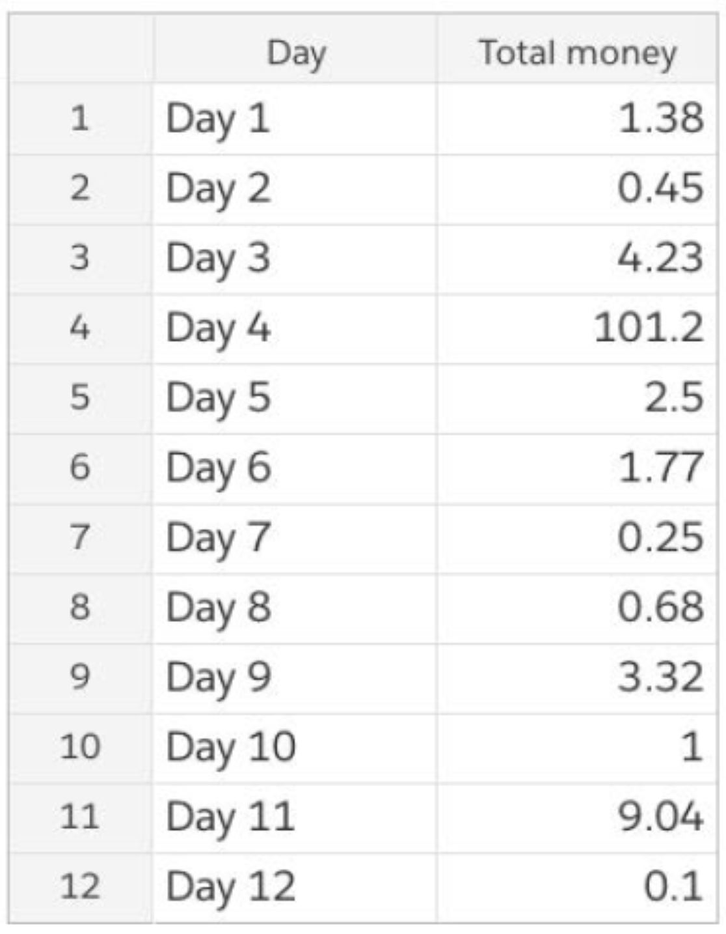
Part III: MLA
Features Engineering
Features Pre-Processing
  Handling outliers
“.(…) An outlier is an observation that lies an abnormal distance from other values in a random sample from a population (…)”
Engineering Statistics Handbook
Global mean: $10.49
Without day 4, mean: $2.25

Slide 27
Part III: MLA
Features Engineering
“.(…) An outlier is an observation that lies an abnormal distance from other values in a random sample from a population (…)”
Engineering Statistics Handbook
Features Pre-Processing
  Finding outliers
  …calculate the mean and standard deviation of the numeric column and check if any values lie outside the range defined by μ±kσ, where μ is the mean, σ is the standard deviation, and k is a chosen threshold (commonly k=3).
  Graphically

Slide 28
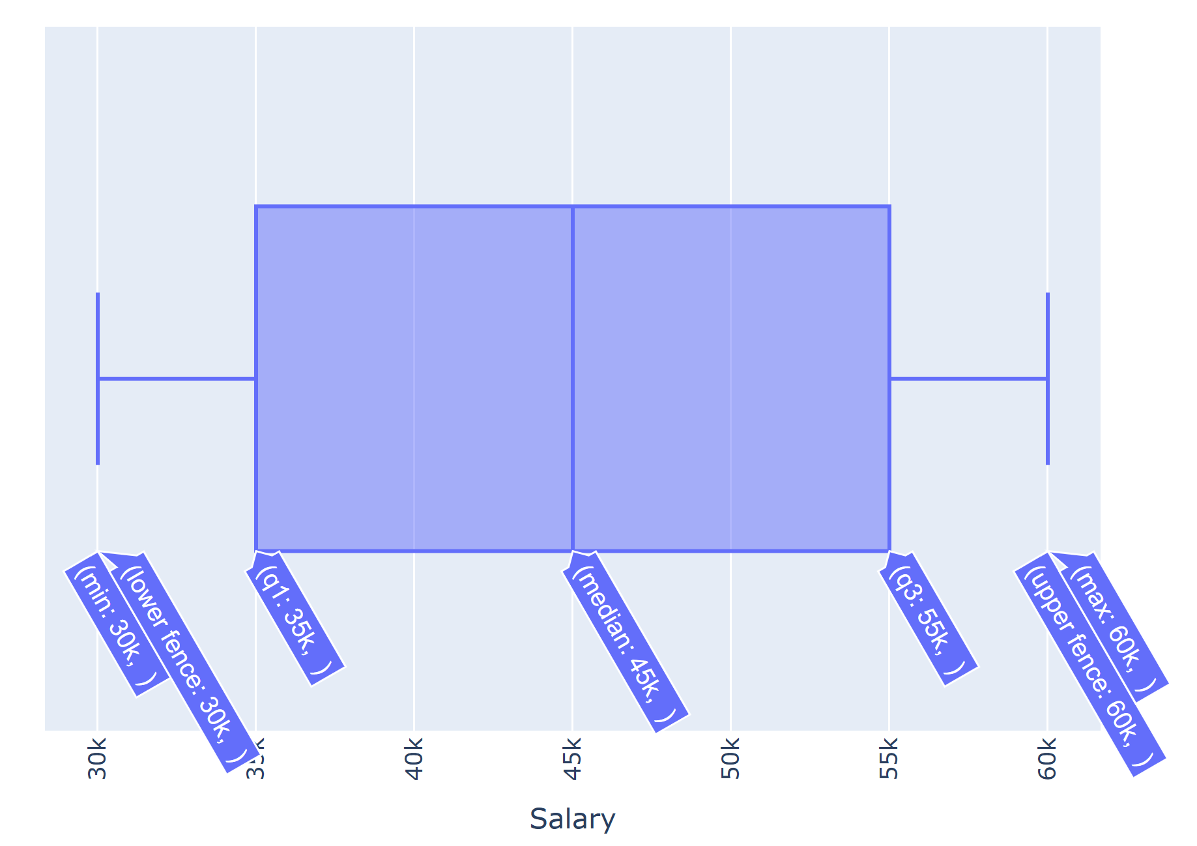
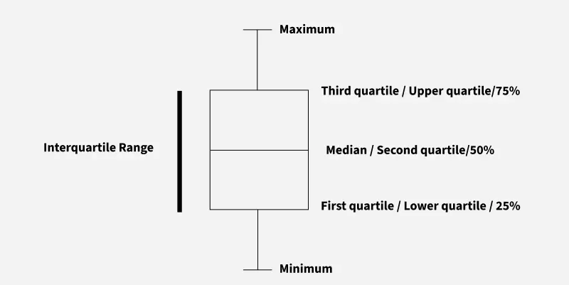
Part III: MLA
Features Engineering
Minimum: Smallest value in the dataset excluding outliers.
First Quartile (Q1): Middle value of the lower half of the data (25th percentile).
Median (Q2): Middle value that splits the dataset into two equal parts (50th percentile).
Third Quartile (Q3): Middle value of the upper half of the data (75th percentile).
Maximum: Largest value in the dataset excluding outliers.
Remember
  Outliers Box Plot representation
See https://www.geeksforgeeks.org/data-visualization/what-is-box-plot-and-the-condition-of-outliers/

Slide 29
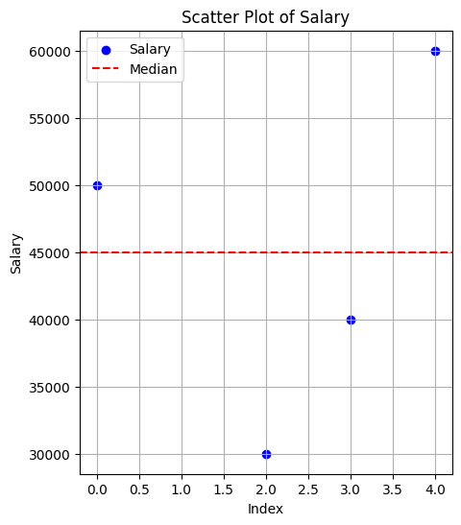
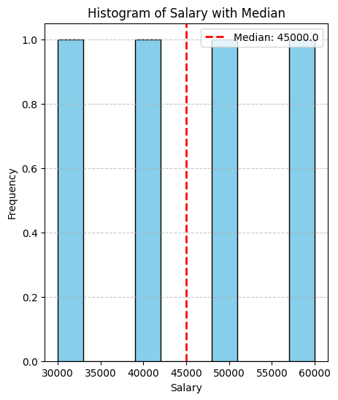
Part III: MLA
Features Engineering
Features Pre-Processing
  Handling outliers
    Removing affecting rows
    Normalizing (replacing values)
    Graphically exploration
      Boxplot
      Scatter-plot
      Histogram
See section “Outliers” in 2_Data_Manipulation_I.ipynb

Slide 30
Part III: MLA
Features Engineering
Practice Lab 2
2_Data_Manipulation_I.ipynb

Slide 31
Part III: MLA
Features Engineering
Features Pre-Processing
  Binning - Grouping Features
    Reduces the complexity of features
    Improves performance
    Can be used for categorical and numerical values
      Example: “Others” category
Notes:
Binning
Agrupar ou segmentar um conjunto de dados em intervalos ou “bins” (“intervalos”)
Por exemplo, ao analisar a idade de um grupo de pessoas, é possível criar bins que agrupem os dados em faixas etárias, como 0-18 anos, 19-35 anos, 36-50 anos e assim por diante,
By grouping continuous numerical values into discrete bins or intervals, binning simplifies complex datasets, making them more interpretable and accessible

Slide 32
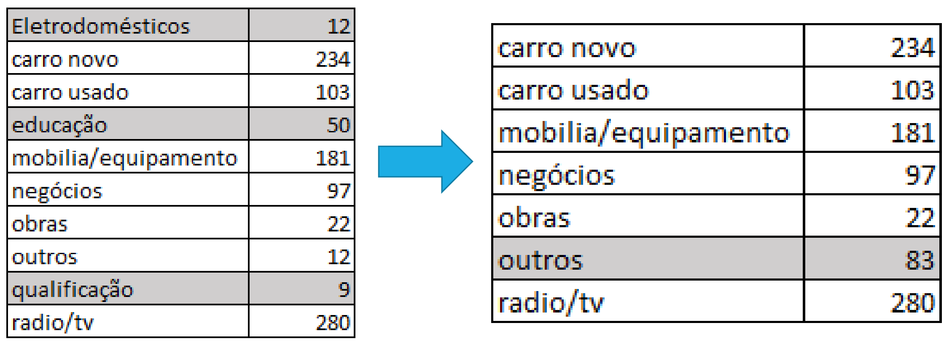
Part III: MLA
Features Engineering
Features Pre-Processing
  Binning - Grouping Features
    Reduces the complexity of features
    Improves performance
    Can be used for categorical and numerical values
      Example: “Others” category
See section “Data Binning” in 2_Data_Manipulation_II.ipynb
Notes:
Binning
Agrupar ou segmentar um conjunto de dados em intervalos ou “bins” (“intervalos”)
Por exemplo, ao analisar a idade de um grupo de pessoas, é possível criar bins que agrupem os dados em faixas etárias, como 0-18 anos, 19-35 anos, 36-50 anos e assim por diante,
By grouping continuous numerical values into discrete bins or intervals, binning simplifies complex datasets, making them more interpretable and accessible

Slide 33
Part III: MLA
Features Engineering
Features Manipulation: Categorical to Numerical (text to numbers)
  Understand categorical encoding techniques for machine learning
  Learn how to implement label encoding and one-hot encoding in Python
  Recognize when to use label encoding vs. one-hot encoding
Notes:
https://www.geeksforgeeks.org/how-to-convert-categorical-variable-to-numeric-in-pandas/

Slide 34
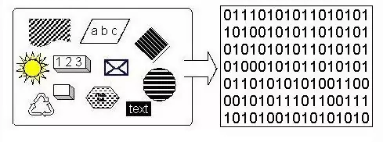
Part III: MLA
Features Engineering
Features Manipulation: Categorical to Numerical (Categorical Encoding)
  Text to Number!
  Datasets “must have” numerical values…before training!
  Convert categories into numbers
  Note: only numerical values can be correlated!
Notes:
https://www.geeksforgeeks.org/how-to-convert-categorical-variable-to-numeric-in-pandas/

Slide 35
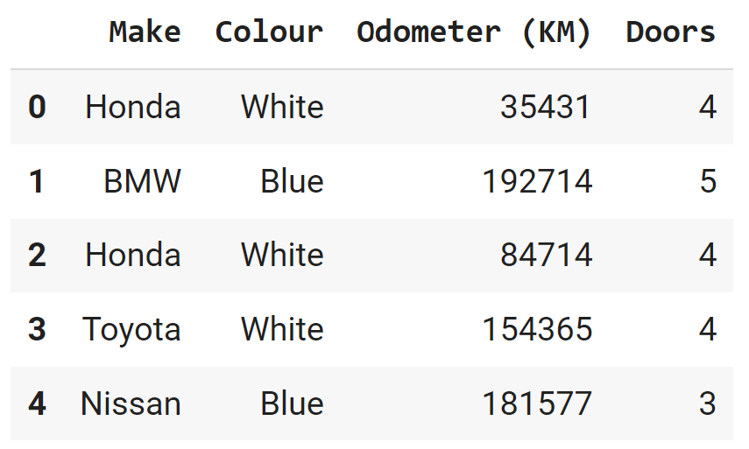
Part III: MLA
Features Engineering
Features Manipulation: Categorical to Numerical (text to numbers)
  Turn categories into numbers, using:
    replace() method
    get_dummies() method
    Label encoding
    OneHotEncoder
Notes:
https://www.geeksforgeeks.org/how-to-convert-categorical-variable-to-numeric-in-pandas/

Slide 36
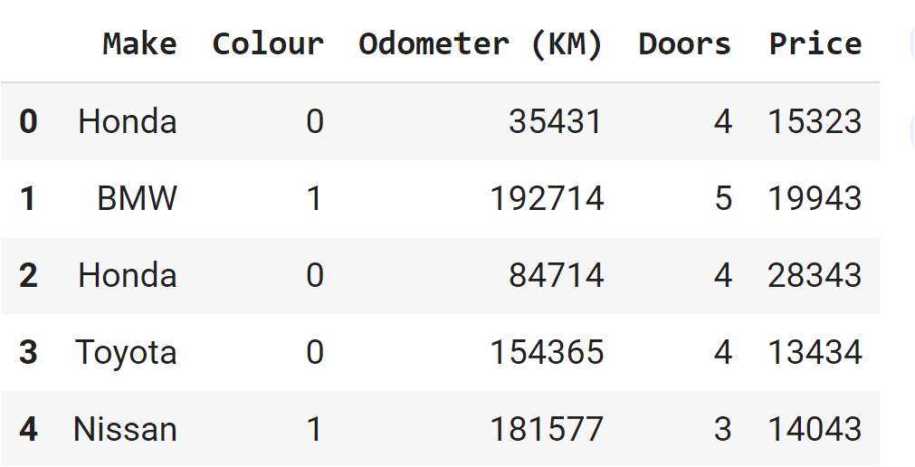
Part III: MLA
Features Engineering
Features Manipulation: Categorical to Numerical
  replace() method
# replacing values
ds[‘Colour'].replace([‘White’, ‘Blue‘], [0, 1], inplace=True)
Notes:
https://www.geeksforgeeks.org/how-to-convert-categorical-variable-to-numeric-in-pandas/

Slide 37
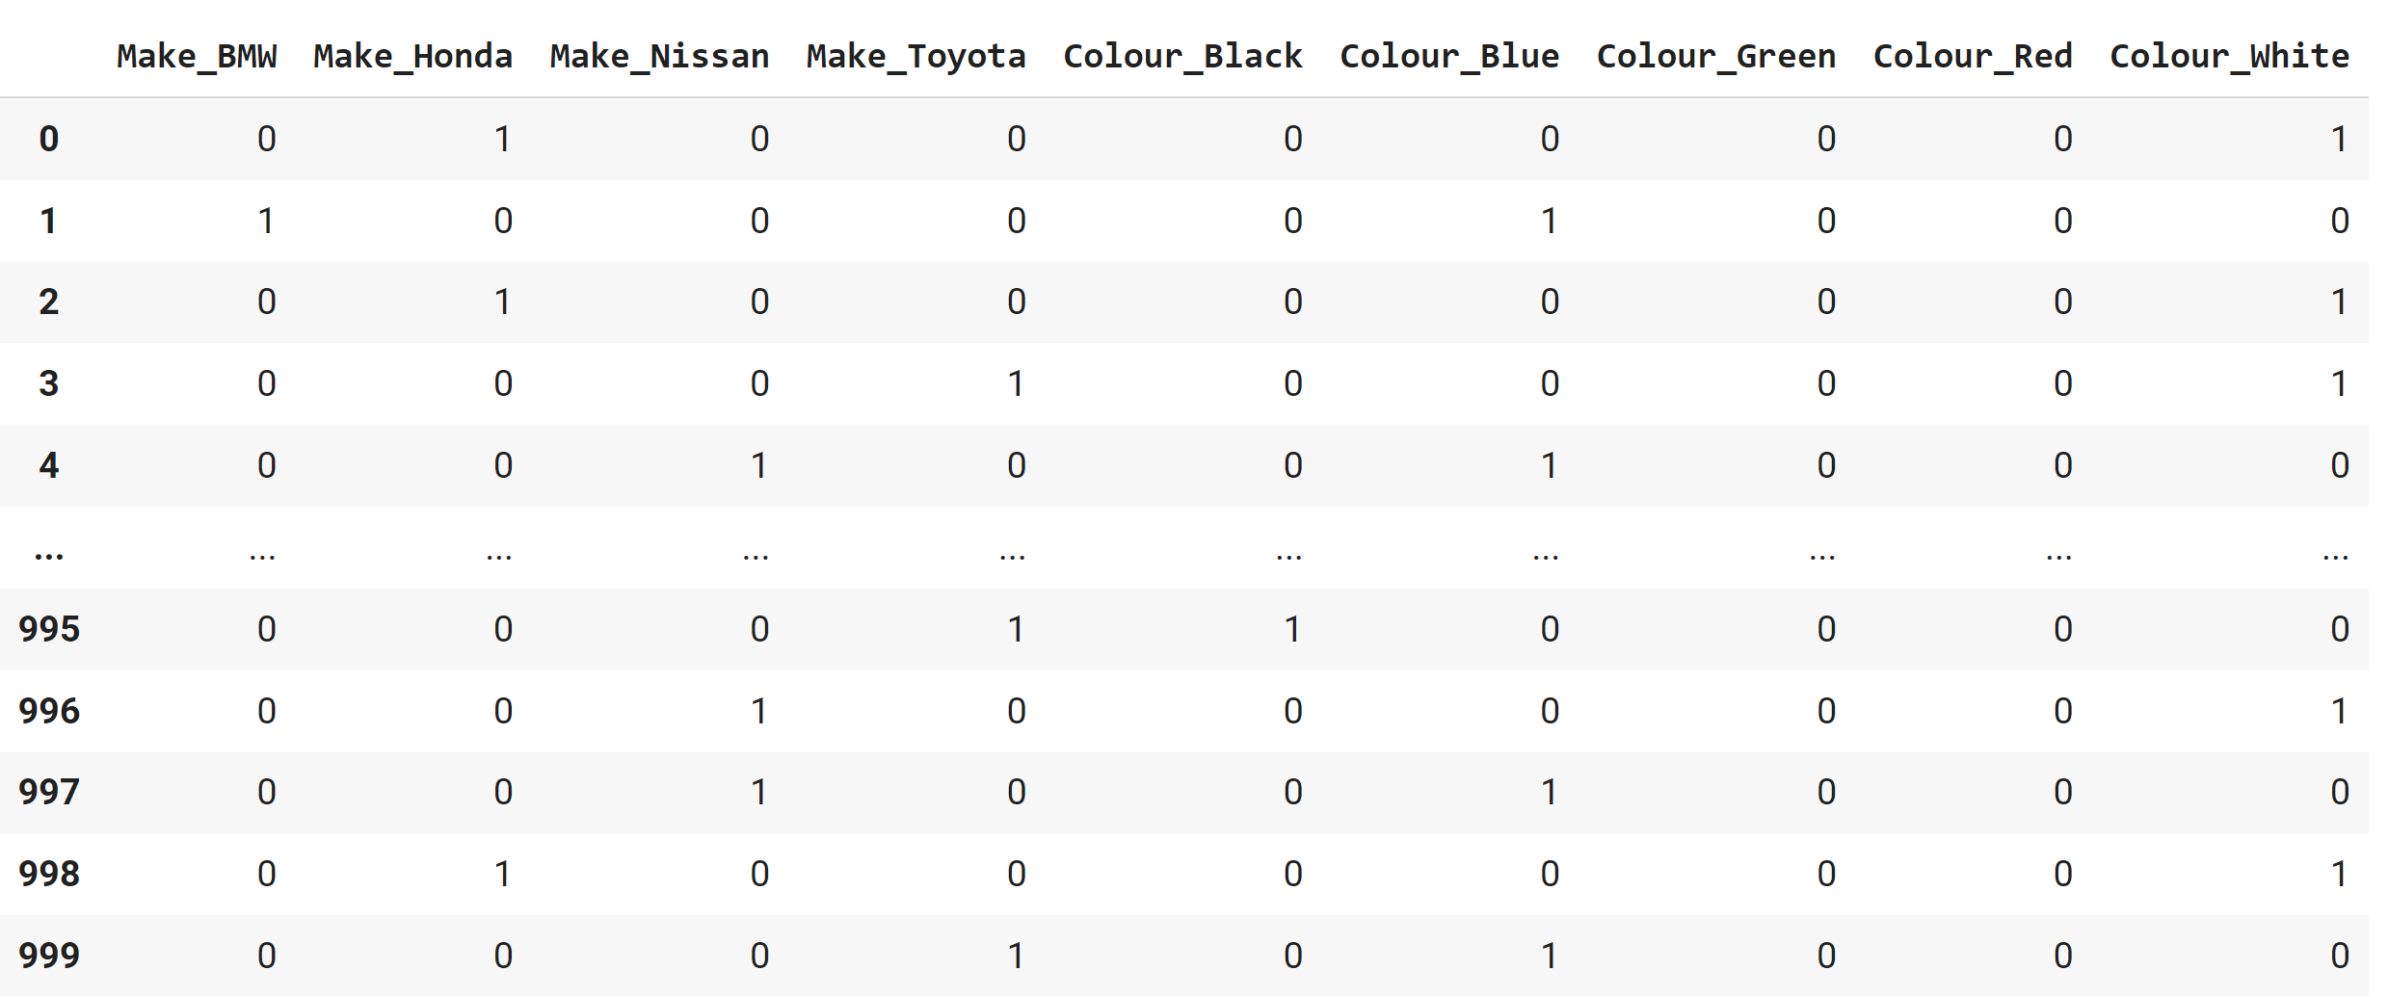
Part III: MLA
Features Engineering
Features Manipulation: Categorical to Numerical
  get_dummies() method
    Create dummy
    columns
    Concatenate datasets
    Drop original columns
dummies = pd.get_dummies(ds[["Make","Colour"]])
dummies dataset
Notes:
https://www.geeksforgeeks.org/how-to-convert-categorical-variable-to-numeric-in-pandas/

Slide 38
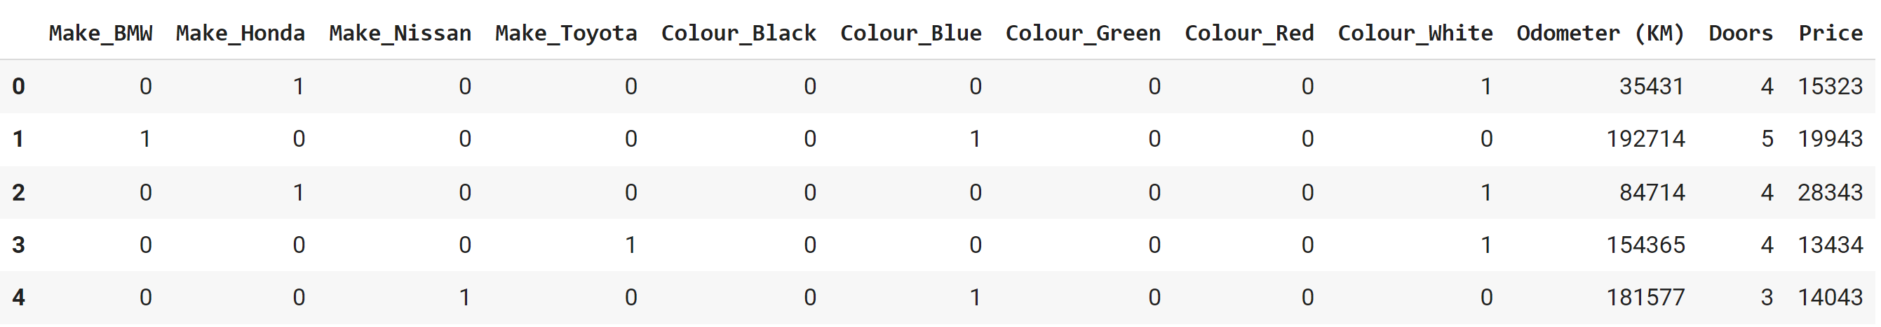
Part III: MLA
Features Engineering
Features Manipulation: Categorical to Numerical
  get_dummies() method
    Create dummy
    columns
    Concatenate datasets
    Drop original columns
dummies = pd.get_dummies(ds[["Make","Colour"], prefix='Make'])
Final numerical dataset
# Create dummy columns for 'Make' using pd.get_dummies
df_dummies = pd.get_dummies(df['Make'], prefix='Make')
# Join the dummy columns back to the original dataframe
df = pd.concat([df, df_dummies], axis=1)
Notes:
https://www.geeksforgeeks.org/how-to-convert-categorical-variable-to-numeric-in-pandas/

Slide 39
Part III: MLA
Features Engineering
Features Manipulation: Categorical to Numerical
  Label Encoding
# Categorical values come numerical
# Create a label encoder object
label_encoder = preprocessing.LabelEncoder()
# Encode labels in the 'Country' column
df['Country'] = label_encoder.fit_transform(df['Country'])
Notes:
https://www.geeksforgeeks.org/how-to-convert-categorical-variable-to-numeric-in-pandas/

Slide 40
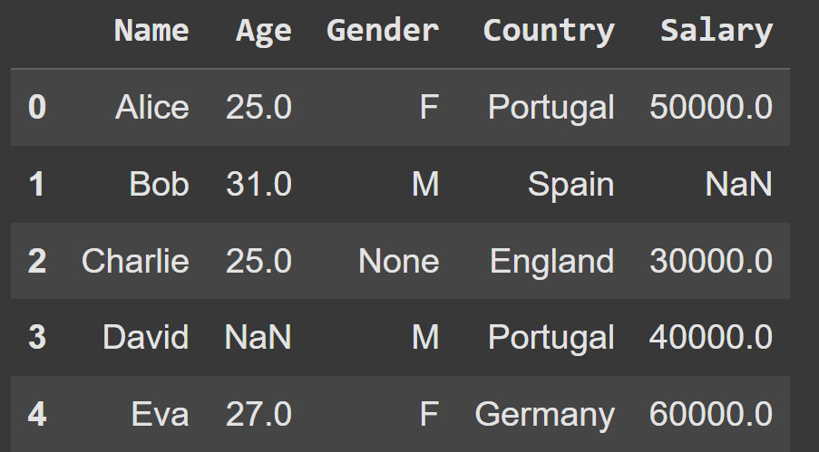
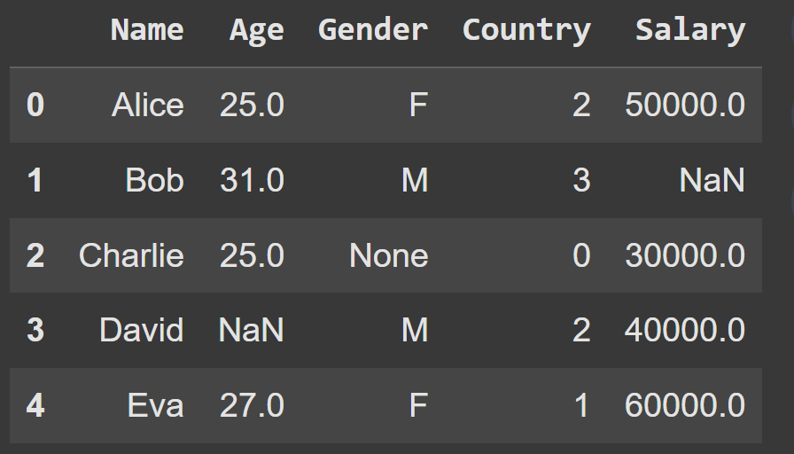
Part III: MLA
Features Engineering
Portugal -> 2
Spain -> 3
England -> 0
Germany -> 1
Features Manipulation: Categorical to Numerical
  Label Encoding
# Categorical values come numerical
# Create a label encoder object
label_encoder = preprocessing.LabelEncoder()
# Encode labels in the 'Country' column
df['Country'] = label_encoder.fit_transform(df['Country'])
Notes:
https://www.geeksforgeeks.org/how-to-convert-categorical-variable-to-numeric-in-pandas/

Slide 41
Part III: MLA
Features Engineering
Features Manipulation: Categorical to Numerical
  OneHotEncoder
Notes:
https://www.geeksforgeeks.org/how-to-convert-categorical-variable-to-numeric-in-pandas/

Slide 42
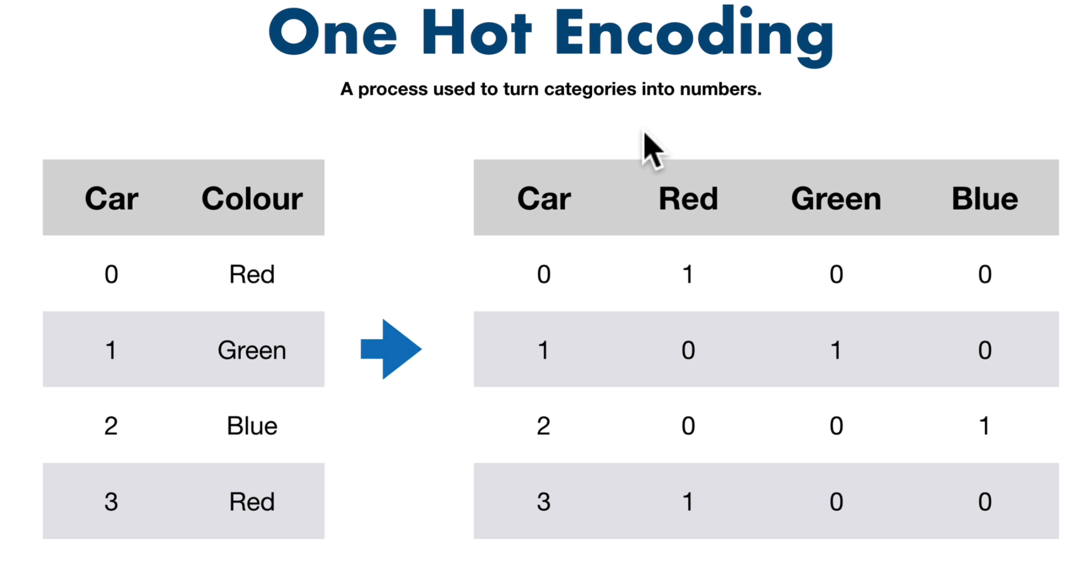
Part III: MLA
Features Engineering
Features Manipulation: Categorical to Numerical
  OneHotEncoder
Notes:
https://www.geeksforgeeks.org/how-to-convert-categorical-variable-to-numeric-in-pandas/

Slide 43
Part III: MLA
Features Engineering
Features Manipulation: Categorical to Numerical
  OneHotEncoder
  Identify the columns to encode
  Apply the encoder
  Create a new dataframe with the encoded columns
  Concat the origical and the new dataset
  Drop the original columns if no longer needed
Notes:
https://www.geeksforgeeks.org/how-to-convert-categorical-variable-to-numeric-in-pandas/

Slide 44
Part III - MLA
Modelling
# Initialize OneHotEncoder
onehot_encoder = OneHotEncoder(sparse_output=False)
#define columns to encode
columns_to_encode = [‘Make', ‘Colour’]
# Apply OneHotEncoding to the intended columns
onehot_encoded = onehot_encoder.fit_transform(df[columns_to_encode])
# Create a new DataFrame with the one-hot encoded columns
encoded_columns = onehot_encoder.get_feature_names_out(columns_to_encode)
encoded_df = pd.DataFrame(onehot_encoded, columns=encoded_columns)
# Concatenate the original DataFrame with the new one-hot encoded columns
df = pd.concat([df, encoded_df], axis=1)
# Drop the original columns if no longer needed
df.drop(columns= encoded_columns, axis=1, inplace=True)
Features Manipulation: Categorical to Numerical
  OneHotEncoder
Notes:
https://www.geeksforgeeks.org/how-to-convert-categorical-variable-to-numeric-in-pandas/

Slide 45
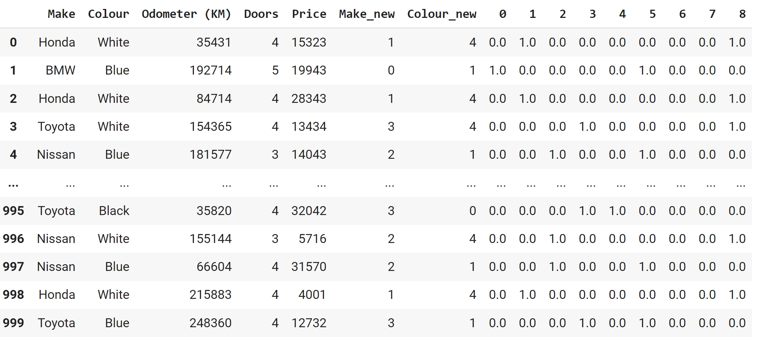
Part III: MLA
Features Engineering
Features Manipulation: Categorical to Numerical
  OneHotEncoder
# Assigning numerical values and storing it in another columns
cs['Make_new'] = cs['Make'].cat.codes
cs['Colour_new'] = cs['Colour'].cat.codes
# Create an instance of One-hot-encoder
one_hot = OneHotEncoder()
enc_data = pd.DataFrame(one_hot.fit_transform(cs[['Make_new', 'Colour_new']]).toarray())
Notes:
https://www.geeksforgeeks.org/how-to-convert-categorical-variable-to-numeric-in-pandas/

Slide 46
Part III: MLA
Features Engineering
When to use One-Hot Encoding:
  You’re building machine learning pipelines or need to transform new datasets with the same categories.
  You need sparse matrix support for large datasets
  The categorical feature is not ordinal
  The number of categorical features is less so one-hot encoding can be effectively applied
Notes:
https://www.geeksforgeeks.org/how-to-convert-categorical-variable-to-numeric-in-pandas/

Slide 47
Part III: MLA
Features Engineering
When to apply get_dummies():
  You’re working primarily with Pandas and don’t need to fit/transform new data.
  Your focus is on simple, quick encoding for analysis
Notes:
https://www.geeksforgeeks.org/how-to-convert-categorical-variable-to-numeric-in-pandas/

Slide 48
Part III: MLA
Features Engineering
get_dummies versus OneHotEncoding:
 | pd.get_dummies | OneHotEncoder
Output | DataFrame | NumPy array (or sparse matrix)
Fit/Transform | No | Yes, must fit first
Handles unknowns in test set | No | Yes (handle_unknown='ignore')
Integration with sklearn pipeline | Limited | Excellent
Drop first column | Yes (drop_first=True) | Yes (drop='first')
Notes:
https://www.geeksforgeeks.org/how-to-convert-categorical-variable-to-numeric-in-pandas/

Slide 49
Part III: MLA
Features Engineering
Notes:
https://www.geeksforgeeks.org/how-to-convert-categorical-variable-to-numeric-in-pandas/

Slide 50
Part III: MLA
Features Engineering
When to apply Label Encoding:
  The categorical feature is ordinal
  The number of categories is quite large as one-hot encoding can lead to high memory
Notes:
https://www.geeksforgeeks.org/how-to-convert-categorical-variable-to-numeric-in-pandas/

Slide 51
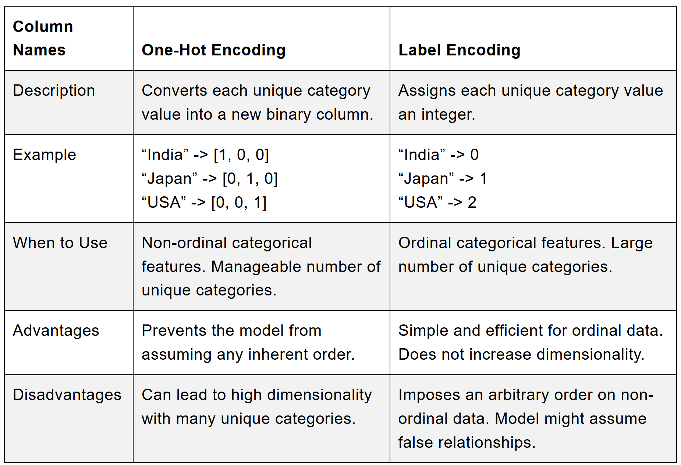
Part III - MLA
Modelling
When One-Hot Encoding:
  The categorical feature is not ordinal
  The number of categorical features is less so one-hot encoding can be effectively applied
When apply Label Encoding:
  The categorical feature is ordinal
  The number of categories is quite large as one-hot encoding can lead to high memory
Notes:
https://www.analyticsvidhya.com/blog/2020/03/one-hot-encoding-vs-label-encoding-using-scikit-learn/

Slide 52
Part III: MLA
Features Engineering
Practice Lab 2
2_Data_Manipulation_II.ipynb

Slide 53
Part III: MLA
Features Engineering
Exploring Lab
3_Data Visualization.ipynb

Slide 54
Progress
Part I
Artificial Intelligence and Machine Learning
Foundations
Part II
Machine Learning
Part III
Machine Learning Algorithms (I)
Part IV
Machine Learning Algorithms (II)
Part V
Machine Learning Algorithms (IV)

Slide 55
References
Feature Scaling - why is it required? by Rahul Saini
Feature Scaling with Scikit-Learn by Ben Alex Keen
Feature Scaling for Machine Learning: Understanding the Difference Between Normalization vs. Standardization by Aniruddha Bhandari

Slide 56
References
Pandas Data Preprocessing — Data Binning
Feature Scaling: Engineering, Normalization, and Standardization
  https://www.analyticsvidhya.com/blog/2020/04/feature-scaling-machine-learning-normalization-standardization/
Complete Guide to Feature Engineering: Zero to Hero
  https://www.analyticsvidhya.com/blog/2021/09/complete-guide-to-feature-engineering-zero-to-hero/

Slide 57
References
The Lifecycle of an AI
  https://labelyourdata.com/articles/lifecycle-of-an-ai-project-stages-breakdown#step_4_scrub_your_data_clean
Examples of Machine Learning Projects
  https://www.datacamp.com/blog/machine-learning-projects-for-all-levels
Elements of AI (free online course)
  https://www.elementsofai.com/

Slide 58
References
Google Colab
  https://colab.research.google.com/
Pandas Tutorial
  https://www.w3schools.com/python/pandas/ref_df_sample.asp

Slide 59
References
Machine Learning. Tom M. Mitchel, McGraw-Hill, 1997
Machine Learning for Everyone
  https://vas3k.com/blog/machine_learning/
Machine Learning Tutorial
  https://www.simplilearn.com/tutorials/machine-learning-tutorial/machine-learning-steps
What is machine learning and how does it work? In-depth guide
  https://www.techtarget.com/searchenterpriseai/definition/machine-learning-ML

Slide 60
Appendices

